Slide 1


Case for Addison’s disease and glucocorticoid replacement
Alberto Falorni
Dipartment of Medicine
University of Perugia
Conflict of interest:
SANOFI
VIROPHARMA Srl

Slide 2
Definition and forms of adrenal insufficiency (AI)
Two main forms:^{1,2}
Primary AI
(Addison’s disease)
Secondary AI
(Hypopituitarism)
Caused by adrenal gland destruction or dysfunction
Prevalence: 93–140 per million
Peak age at diagnosis: 4th decade
Deficit in glucocorticoid and mineralocorticoid
Caused primarily by hypothalamic/pituitary tumours
Prevalence: 150–280 per million
Peak age at diagnosis: 6th decade
Deficit in glucocorticoid
(not mineralocorticoid)
May have multiple pituitary hormone deficiencies³
Tertiary/temporary AI may occur after a prolonged period of endogenous or exogenous pharmaceutical glucocorticoid exposure¹
Arlt W. In: Harrison’s Principles of Internal Medicine, 18th ed. 2012. Chapter 342, pp. 2940–2961
Artl W and Allolio B. Lancet 2003;361:1881–1893
Regal M et al. Clin Endocrinol 2001;55:735–740
Notes:
2
2

Slide 3
Recommended therapeutic approach to primary adrenal insufficiency
Glucocorticoid replacement
Immediate-release hydrocortisone dosing:
Start on 15–25 mg
hydrocortisone per 24 hours
Administer in 2 or 3 divided doses
Administer ⅔ or ½ the dose, respectively, immediately after waking
Once-daily modified-release hydrocortisone dosing:
Dose based on clinical response, 20–40 mg/day
Administer once daily in the morning
Mineralocorticoid replacement
Not required if hydrocortisone dose is >50 mg per 24 hours
Dosing:
Start on 100 μg fludrocortisone as a single dose immediately after waking
Optimised doses usually 50–250 μg/day
Adrenal androgen replacement
Consider in:
Patients with impaired well-being and mood despite optimised glucocorticoid/ mineralocorticoid replacement therapy
Women with symptoms and signs of androgen deficiency
Dosing:
DHEA 25–50 mg as a single morning dose
In women, also consider transdermal testosterone

Slide 4
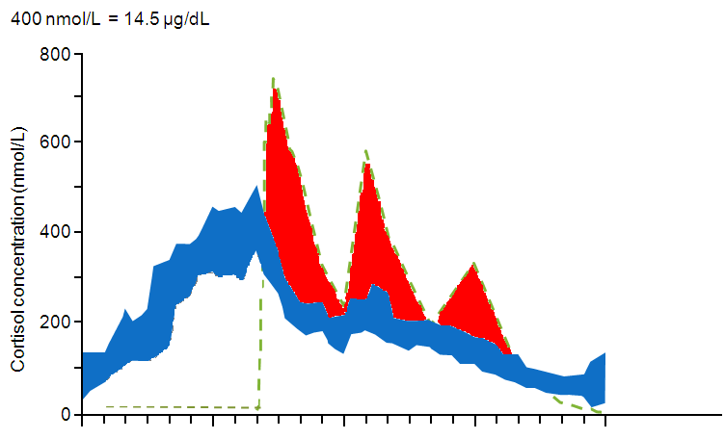
Late afternoon/evening peaks and troughs
2
Immediate-release
hydrocortisone tablet TID¹
90% CI healthy volunteers²
Elevated late afternoon or evening
levels have been associated with:
Alterations in glucose tolerance and insulin sensitivity³
Coronary artery calcification⁴
00.00
06.00
12.00
18.00
24.00
Clock time
Figure derived from Johannsson et al. and healthy volunteer data based on Vgontzas AN et al.
1. Johannsson G et al. J Clin Endocrinol Metab 2012;97:473–481; 2. Vgontzas AN et al. J Clin Endocrinol Metab 2001;86:3787–3794;
3. Plat L et al. J Clin Endocrinol Metab 1999;84:3082–3092; 4. Matthews K et al. Psychos Med 2006;68:657–661;
4. García-Borreguero D et al. J Clin Endocrinol Metab 2000;85:4201–4206.

Slide 5
Potential negative outcomes associated with classical
substitutive therapy of adrenal insufficiency
Classical substitutive therapy with glucocorticoids
Premature
mortality
  High frequency of infections/
  hospitalization
Reduced
well-being and quality of life
Altered
metabolic
profile
Reduced
bone mineral
density
HIGHLY
CONTROVERSIAL
??
Bergthorsdottir et al. JCEM 2006, Smans LCCJ et al. ECE 2011, Hahner et al. JCEM 2007,
Filipsson et al. JCEM 2007, Zelissen et al. Ann Intern Med 1994; Lövås et al EJE 2009
5
5

Slide 6
Improved Serum Cortisol Profile
with Dual-Release HC tablet
Cortisol conc. (nM)
Dual-release HC tablet
800
Immediate release
hydrocortisone tablet
0-24 h (8 AM-8 AM) | Total exposure 19% lower on Dual-release than TID
0-4 h (8 AM-12.00) | Morning exposure 6% higher on Dual-release than TID
4-12 h (12.00-8 PM) | Afternoon and early evening exposure 38% lower on Dual-release than TID
12-24 h (8 PM-8AM) | Night exposure 41% lower on Dual-release than TID
600
400
200
0
00.00
06.00
12.00
18.00
24.00
Clock time
Johannsson G et al. J Clin Endocrinol Metab 2012;97:473–481

Slide 7
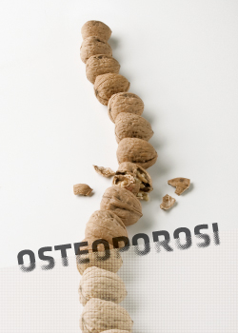
ADDISON’S DISEASE and OSTEOPOROSIS:
a controversial issue

Slide 9
BMD and ADDISON’S DISEASE
 | n | BMD males | BMD females
Devolagear et al. 1987 | 33 | NS | ↓
Florkowski et al. 1994 | 14 | NS | ↓
Zelissen et al. 1994 | 91 | ↓ | NS
Valero et al. 1994 | 30 | NS | ↓
Braatvedt et al. 1999 | 29 | ↓ | NS
Jodar et al. 2003 | 25 | NS | NS
Arlt et al. 2006 | 15 | NS | NS
Gurnell et al. 2008 | 100 | ↓ | ↓
Løvås et al. 2009 | 292 | ↓ | ↓
Koetz et al. 2012 | 86 | NS | NS

Slide 10
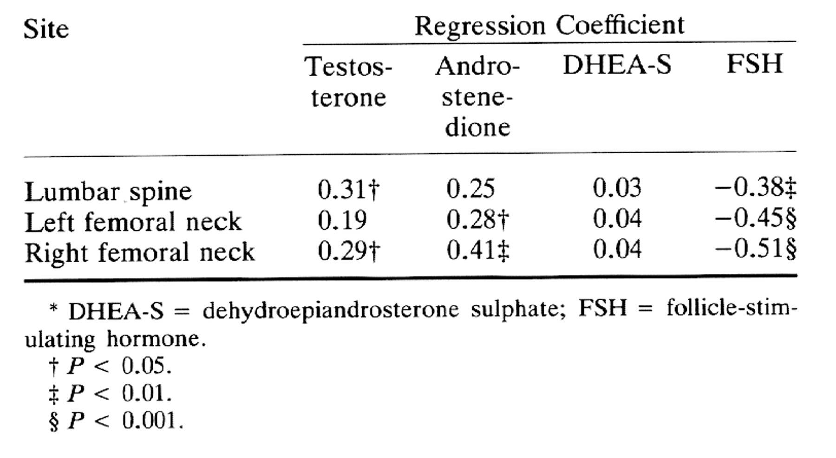
Coefficients of Correlation between Bone Mineral Density and Plasma Concentrations of Androgens and Follicle-stimulating Hormone in Women with Addison Disease*.
Zelissen P M J et al. Ann Intern Med 1994;120:207-210
©1994 by American College of Physicians
Notes:
Coefficients of Correlation between Bone Mineral Density and Plasma Concentrations of Androgens and Follicle-stimulating Hormone in Women with Addison Disease*

Slide 11
Mean change in BMD in 100 Addison patients treated for 12 months with DHEA-supplementation or placebo
Baseline:
Lumbar spine:
39% males osteopenic
39% females “
7% males osteoporotic
5% females “
Femoral neck:
39% males osteopenic
39% females “
2% females osteoporotic
Gurnell M et al
JCEM 2008

Slide 12
Bone Mineral Density in
patients with long-term treated
Addison’s disease (n=25 patients)
Jodar et al Clinical Endocrinology 2003

Slide 13
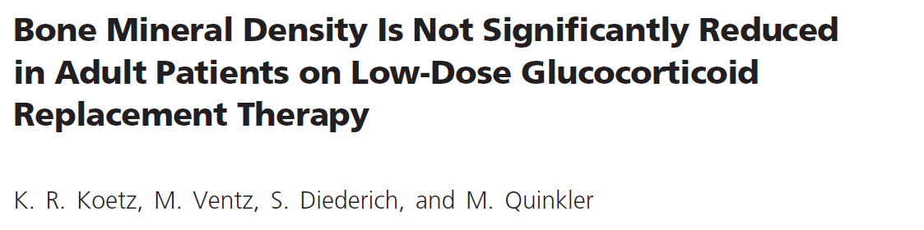
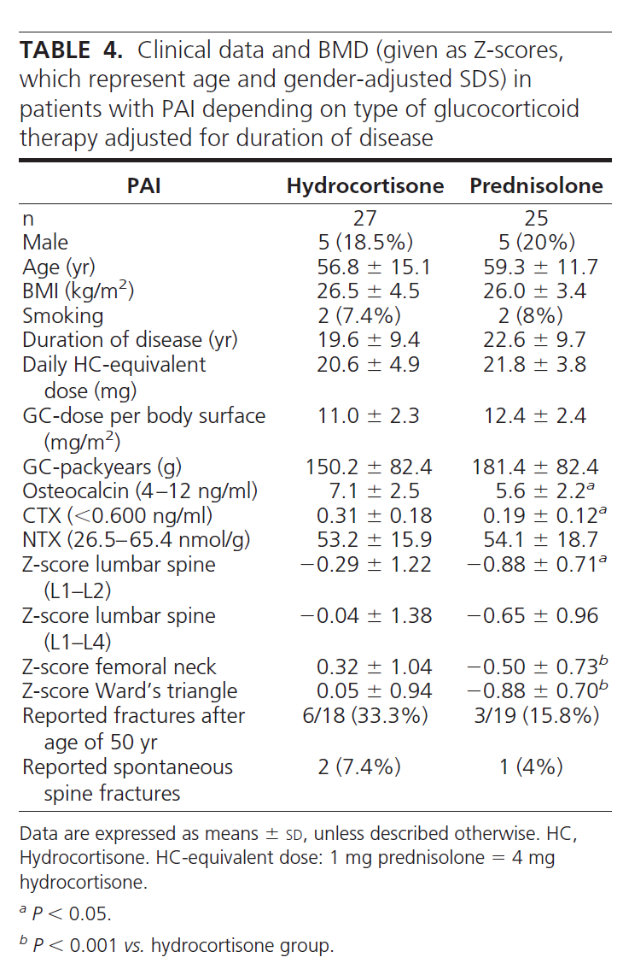
JCEM 2012

Slide 14
BMD Z-scores in Addison’s
disease patients from
Norway (n=187) and UK
and New Zealand (n=105)
Løvås et al EJE 2009

Slide 15
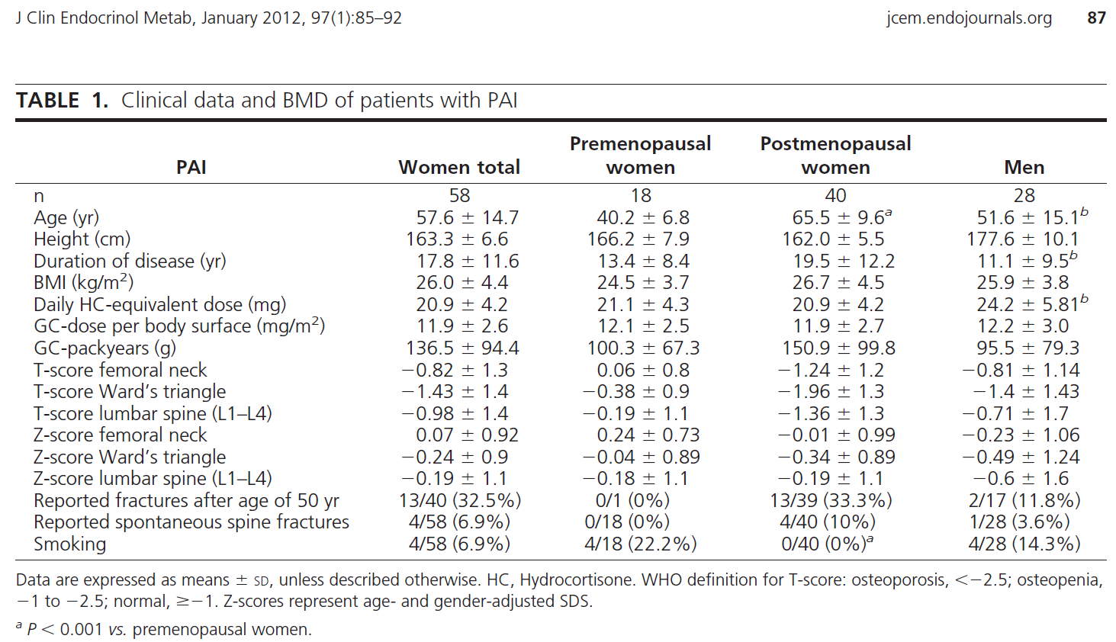

Slide 16
Correlation of corticosteroid dose and duration of Addison’s disease with BMD
(n=29 patients)
Braatvedt et al Osteoporosis Internat 1999

Slide 17
Correlation between weight-adjusted glucocorticoid
dose and femoral neck Z-scores in Norwegian patients
Løvås et al EJE 2009

Slide 18
Z-score lumbar spine
Z-score femoral neck
Total males females
Total males females
T-score lumbar spine
T-score femoral neck
Box-plot of BMD Z-score and T-score subdivided according to gender in 73 pz with Addison’s disease (in treatment
with 15-30 mg/d HC)
Total males females
Total males females

Slide 19
Z-score lumbar spine
Z-score femoral neck
Disease duration (yrs)
Disease duration (yrs)
Correlation between disease duration and femoral or lumbar BMD Z-score

Slide 20
Follow-up of lumbar and femoral Z-score in patients with no specific treatment
Z-score lumbar spine
Z-score femoral neck
Duration of follow- up (yrs)
Duration of follow- up (yrs)

Slide 21
Follow-up of lumbar and femoral Z-score in patients for whom a BMD analysis was available since the first year after diagnosis
Z-score lumbar spine
Z-score femoral neck
Duration of follow- up (yrs)
Duration of follow- up (yrs)

Slide 22


Correlation between femoral Z-score and corrected daily dose of hydrocortisone in Addison patients
Z-score femoral neck MALES
Z-score femoral neck FEMALES
Hydrocortisone (mg/kg/d)
Hydrocortisone (mg/kg/d)

Slide 23
In our cohort of patients…
baseline concentrations of 25OH-vitamin D were 18,65 ng/ml (range 4-57,99) with no significant differences between females (median 18,35, range 4-27,63) and males (median 22,12 range 7,51-57,99)

Slide 24
Recommended therapeutic approach to primary adrenal insufficiency
Glucocorticoid replacement
Immediate-release hydrocortisone dosing:
Start on 15–25 mg
hydrocortisone per 24 hours
Administer in 2 or 3 divided doses
Administer ⅔ or ½ the dose, respectively, immediately after waking
Once-daily modified-release hydrocortisone dosing:
Dose based on clinical response, 20–40 mg/day
Administer once daily in the morning
Mineralocorticoid replacement
Not required if hydrocortisone dose is >50 mg per 24 hours
Dosing:
Start on 100 μg fludrocortisone as a single dose immediately after waking
Optimised doses usually 50–250 μg/day
Adrenal androgen replacement
Consider in:
Patients with impaired well-being and mood despite optimised glucocorticoid/ mineralocorticoid replacement therapy
Women with symptoms and signs of androgen deficiency
Dosing:
DHEA 25–50 mg as a single morning dose
In women, also consider transdermal testosterone
+ Cholecalciferol 25.000 UI every two weeks

Slide 25
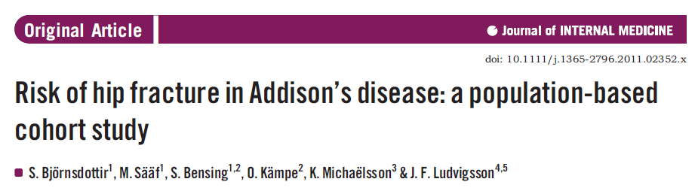

Slide 26
In summary….
Most of studies indicate that patients with Addison’s disease have a
significant lower BMD than expected
If HC 15-30 mg/d treatment is carried on:
1. BMD is not influenced by disease duration and is not affected by
treatment during the follow-up
2. High doses of HC (and other synthetic glucocorticoids) may reduce BMD
3. In our cohort almost every AD patient had a vitamin D deficiency
4. Loss of BMD seems to be more related to AD per se than to HC treatment
5. Causes of BMD loss in AD patients include:
a. Cortisol deficiency
b. Asthenia and reduced physical activity
c. Anorexia and body weight loss
d. Vitamin D deficiency
e. Hyponatremia
f. DHEA deficiency
6. No significant differences were observed between patients with isolated
AD and patients with APS II

